Slide 1

Resource Allocation in STAR-RIS Assisted Networks
Speaker: Pei-Hsuan Li
(erin.ee11@nycu.edu.tw)
Advisor: Kai-Ten Feng, Ph.D, Professor
(ktfeng@nycu.edu.tw)
Institute of Communications Engineering
National Yang Ming Chiao Tung University (NYCU) Hsinchu, Taiwan
December 25th, 2024

Slide 2
Outline
Introduction
What is STAR-RIS?
Key Features
Hardware Design
Communication Model
NOMA
OMA
Problem Formulation
Optimization approach
Overview of Genetic Algorithm
Simulation
Simulation Setup
Simulation Results
Symmetric Case
Asymmetric Case
Conclusion
References

Slide 3

Outline
Introduction
What is STAR-RIS?
Key Features
Hardware Design
Communication Model
NOMA
OMA
Problem Formulation
Optimization approach
Overview of Genetic Algorithm
Simulation
Simulation Setup
Simulation Results
Symmetric Case
Asymmetric Case
Conclusion
References

Slide 4

Introduction
What is STAR-RIS?
STAR-RIS stands for Simultaneous Transmission and Reflection Reconfigurable Intelligent Surfaces.
Unlike traditional reflecting-only RIS, STAR-RIS supports both reflection and transmission, enabling full-space 360° coverage.
Key Features
Full-Space Coverage
Aesthetic and Flexible Design
Improved System Flexibility
NOMA
Hardware Design

Slide 5
Outline
Introduction
What is STAR-RIS?
Key Features
Hardware Design
Communication Model
NOMA
OMA
Problem Formulation
Optimization approach
Overview of Genetic Algorithm
Simulation
Simulation Setup
Simulation Results
Symmetric Case
Asymmetric Case
Conclusion
References

Slide 6
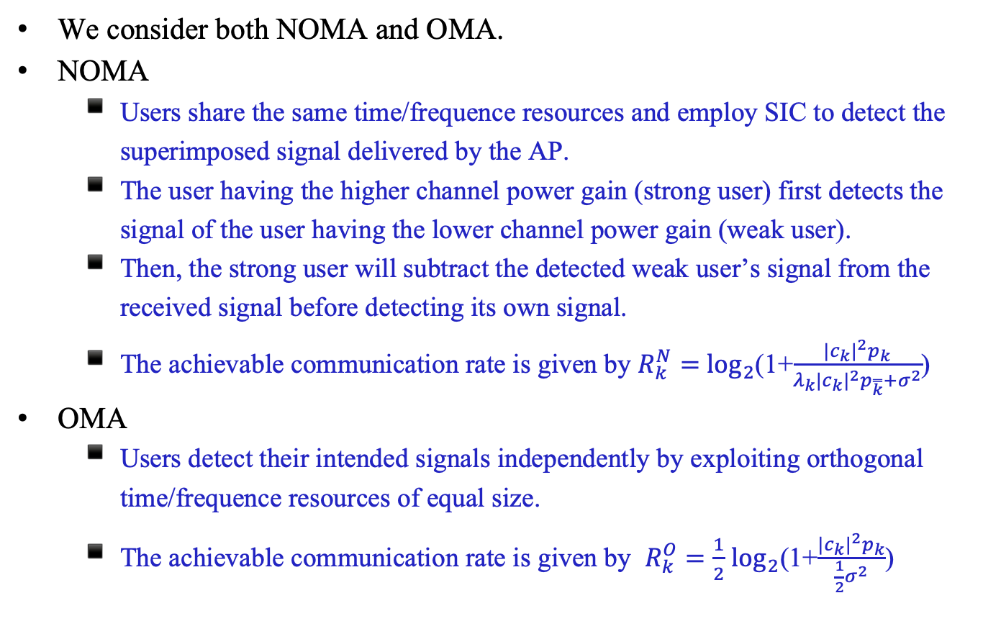

Communication Model
We consider both NOMA and OMA.
NOMA
Users share the same time/frequence resources and employ SIC to detect the superimposed signal delivered by the AP.
The user having the higher channel power gain (strong user) first detects the signal of the user having the lower channel power gain (weak user).
Then, the strong user will subtract the detected weak user’s signal from the received signal before detecting its own signal.
The achievable communication rate is given by $R_{k}^{N}=$ $\log_{2}$(1+$\frac{{|c_{k}|}^{2}p_{k}}{{λ_{k}|c_{k}|}^{2}p_{\overset{̿}{k}}+σ^{2}}$)
OMA
Users detect their intended signals independently by exploiting orthogonal time/frequence resources of equal size.
The achievable communication rate is given by $R_{k}^{O}=\frac{1}{2}$ $\log_{2}$(1+$\frac{{|c_{k}|}^{2}p_{k}}{\frac{1}{2}σ^{2}}$)

Slide 7
Outline
Introduction
What is STAR-RIS?
Key Features
Hardware Design
Communication Model
NOMA
OMA
Problem Formulation
Optimization approach
Overview of Genetic Algorithm
Simulation
Simulation Setup
Simulation Results
Symmetric Case
Asymmetric Case
Conclusion
References

Slide 8
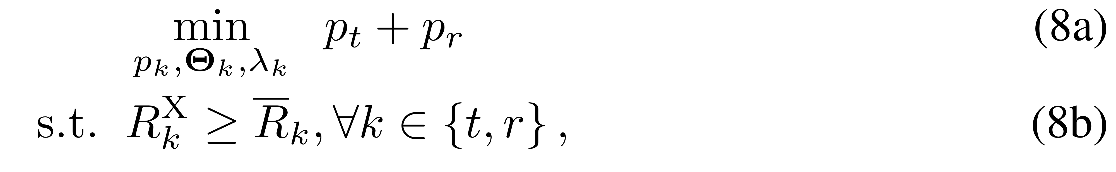
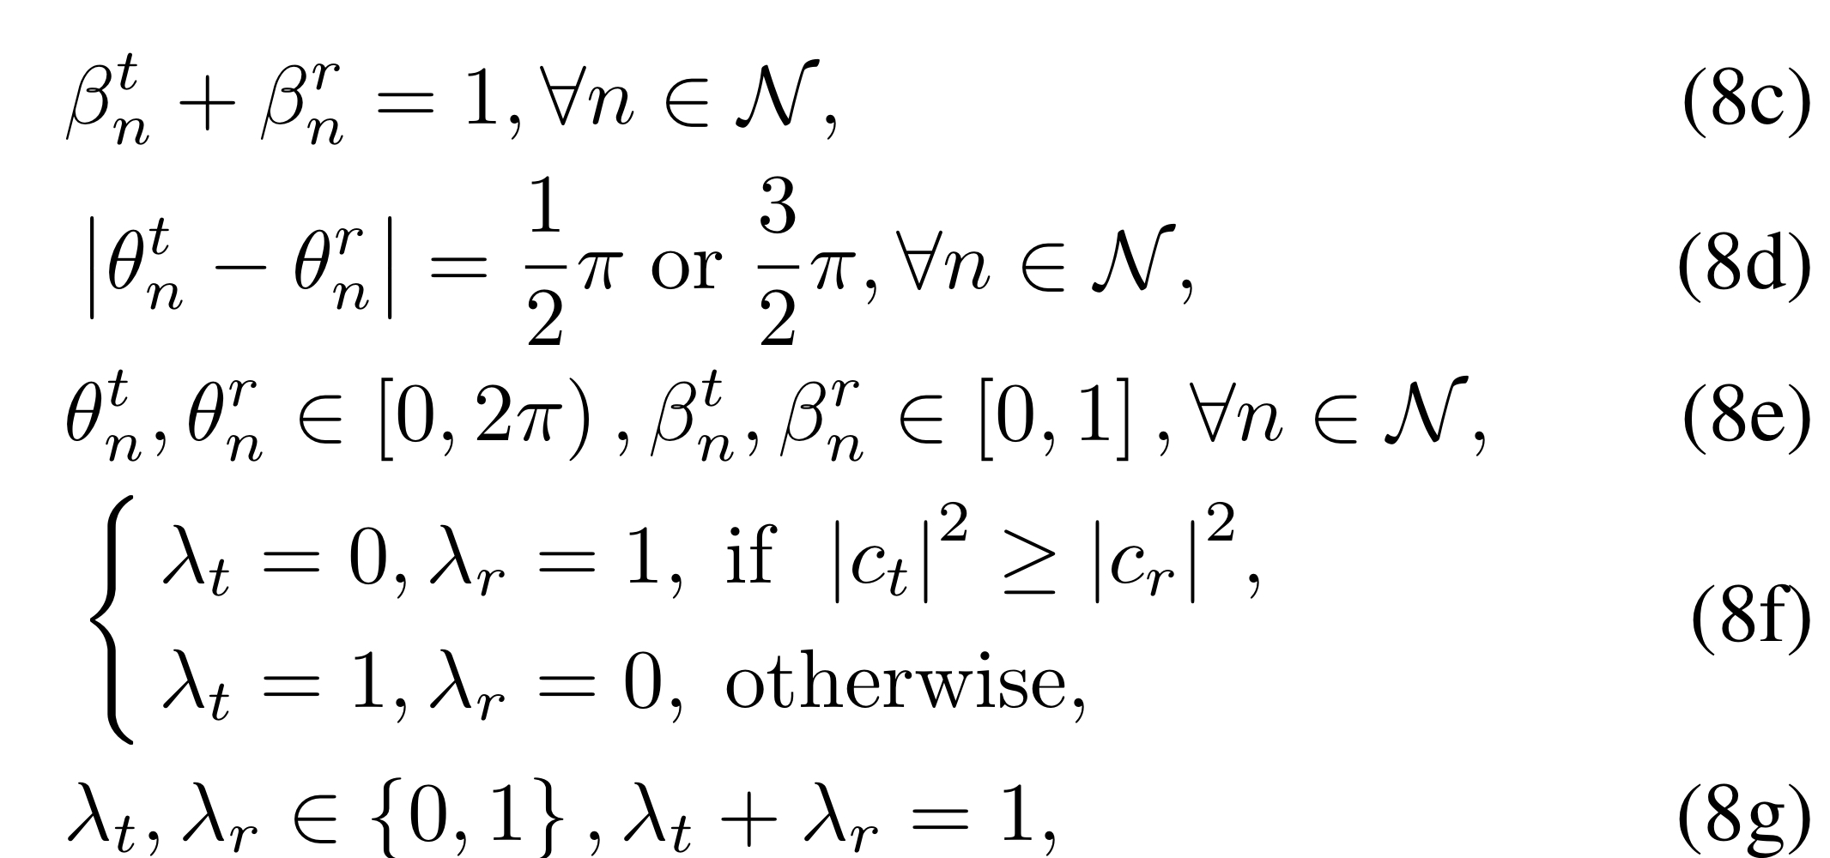

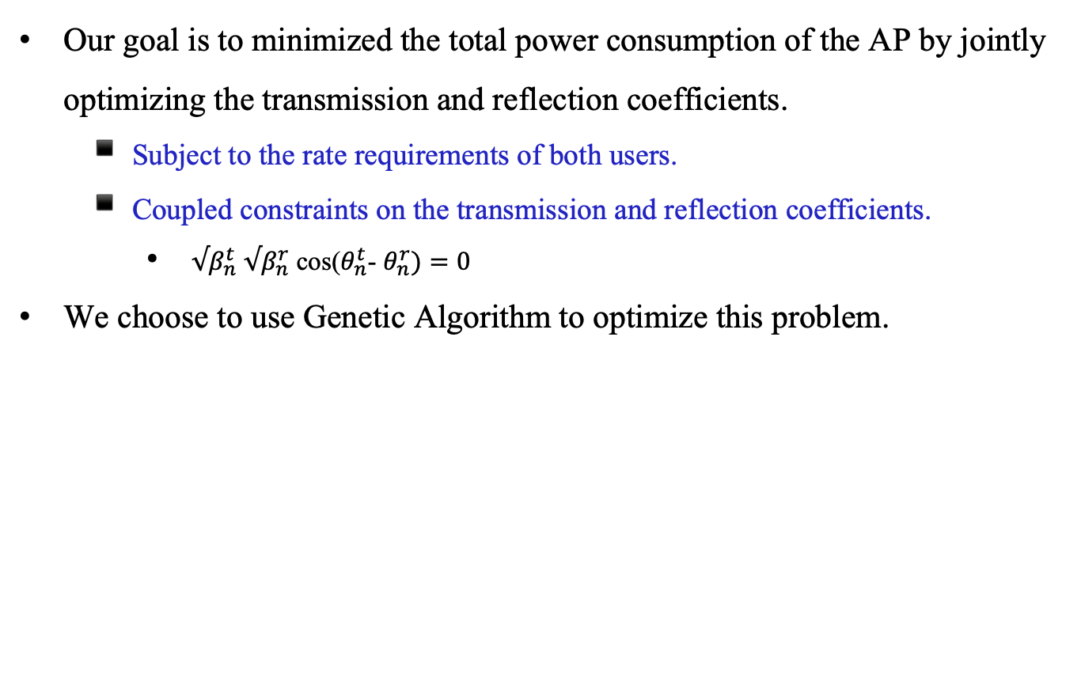
Problem Formulation
Our goal is to minimized the total power consumption of the AP by jointly optimizing the transmission and reflection coefficients.
Subject to the rate requirements of both users.
Coupled constraints on the transmission and reflection coefficients.
$√β_{n}^{t}$ $√β_{n}^{r}$ cos($θ_{n}^{t}$- $θ_{n}^{r})=0$
We choose to use Genetic Algorithm to optimize this problem.

Slide 9
Outline
Introduction
What is STAR-RIS?
Key Features
Hardware Design
Communication Model
NOMA
OMA
Problem Formulation
Optimization approach
Overview of Genetic Algorithm
Simulation
Simulation Setup
Simulation Results
Symmetric Case
Asymmetric Case
Conclusion
References

Slide 10
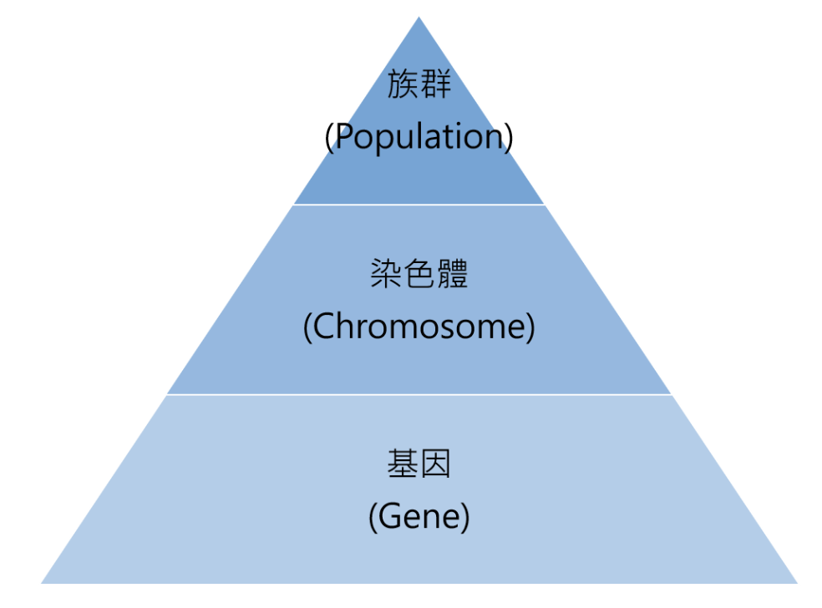
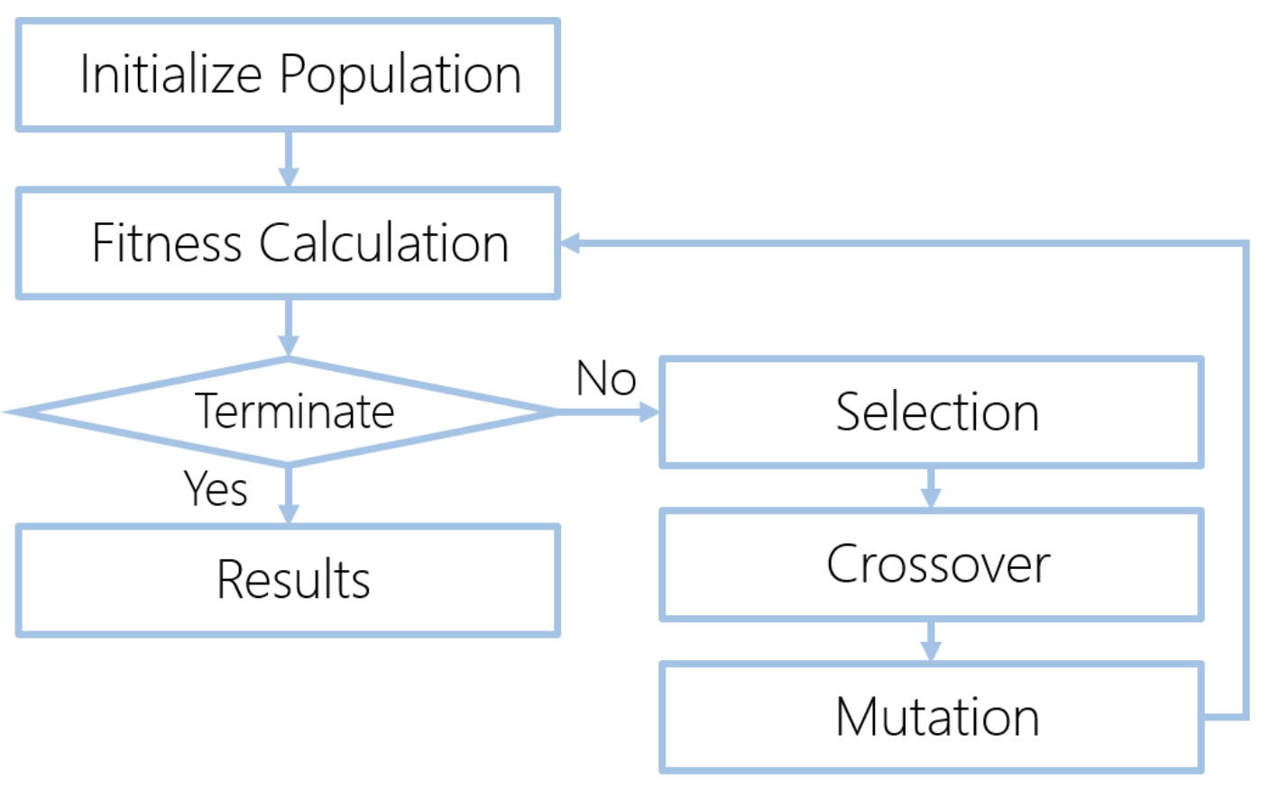

Optimization using Genetic Algorithm
The procedure of Genetic Algorithm(GA)

Slide 11
Outline
Introduction
What is STAR-RIS?
Key Features
Hardware Design
Communication Model
NOMA
OMA
Problem Formulation
Optimization approach
Overview of Genetic Algorithm
Simulation
Simulation Setup
Simulation Results
Symmetric Case
Asymmetric Case
Conclusion
References

Slide 12
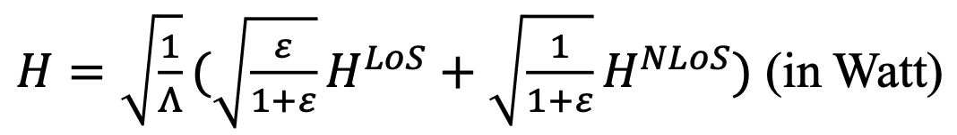
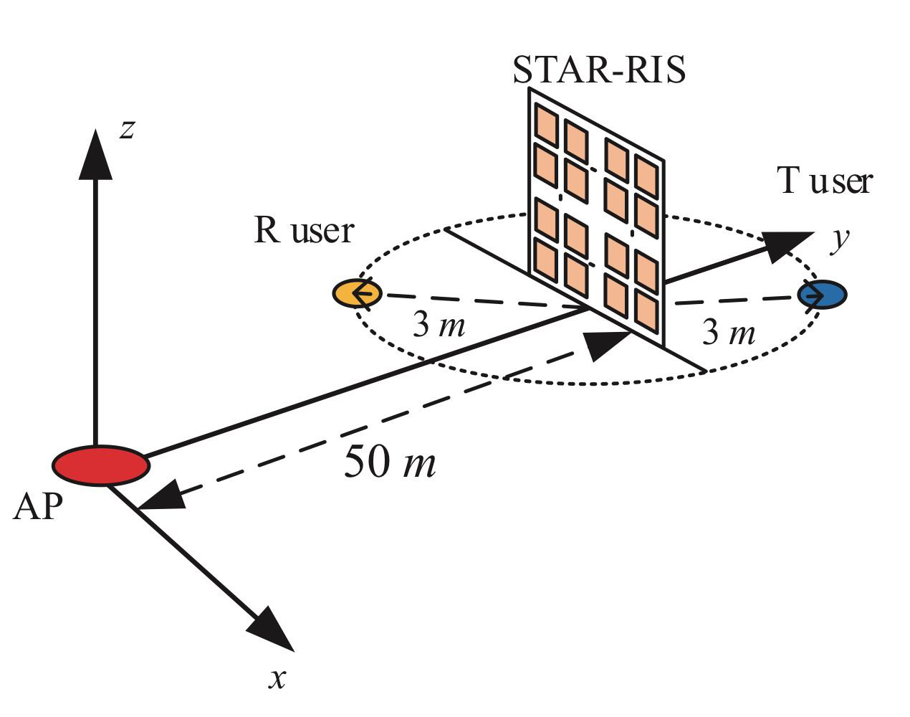

Simulation Setup
The BS-user channel is modeled as Rician fading channel.
For asymmetric case
Suppose T user is the strong user.
Rate requirement of T user is 18 times that of R user.
For symmetric case
Rate requirements for T user and R user are the same.

Slide 13
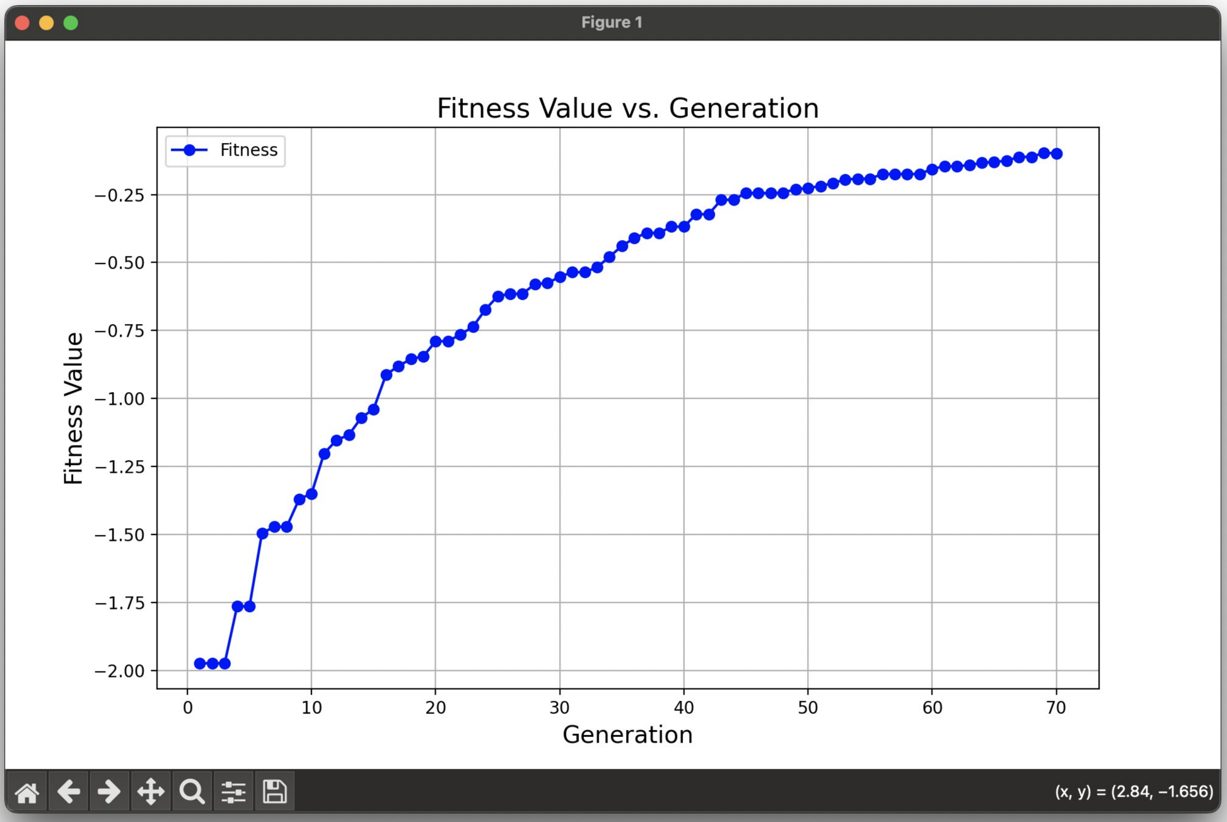

Simulation Results(1/5)
Fitness value
Convergence

Slide 14
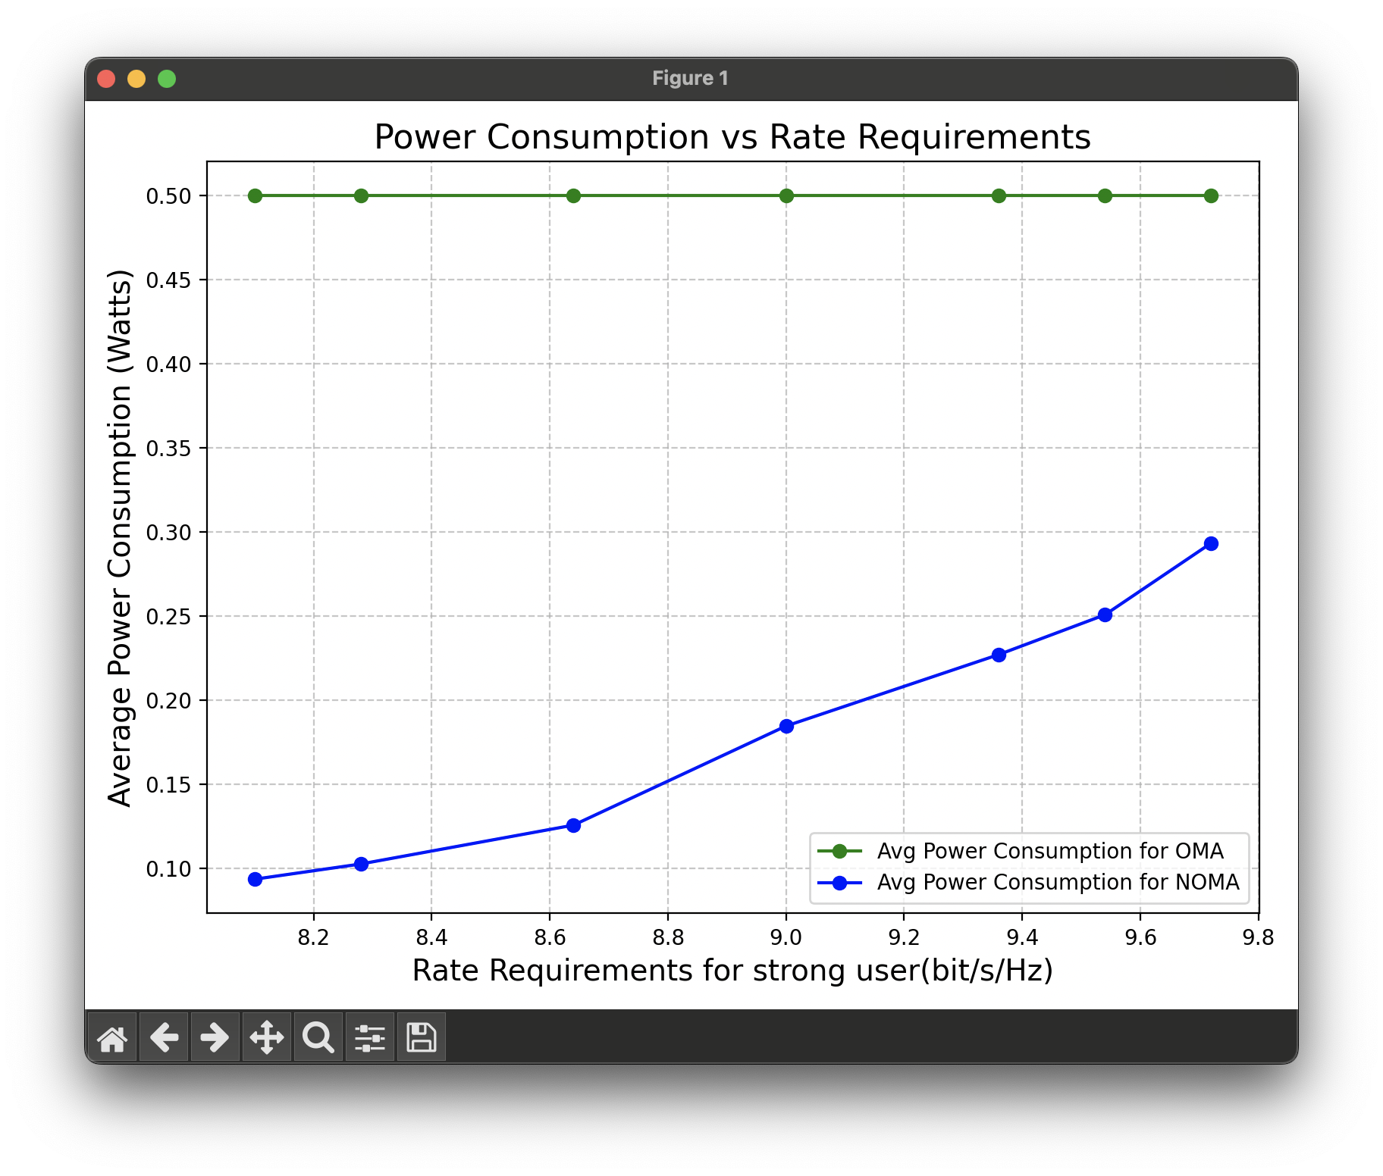

Simulation Results(2/5)
Asymmetric Case
OMA struggles to establish a clear trend due to the unequal rate requirements of the users. This disparity negatively impacts OMA's performance.
NOMA demonstrates robust performance by leveraging SIC to mitigate noise for the strong user.

Slide 15
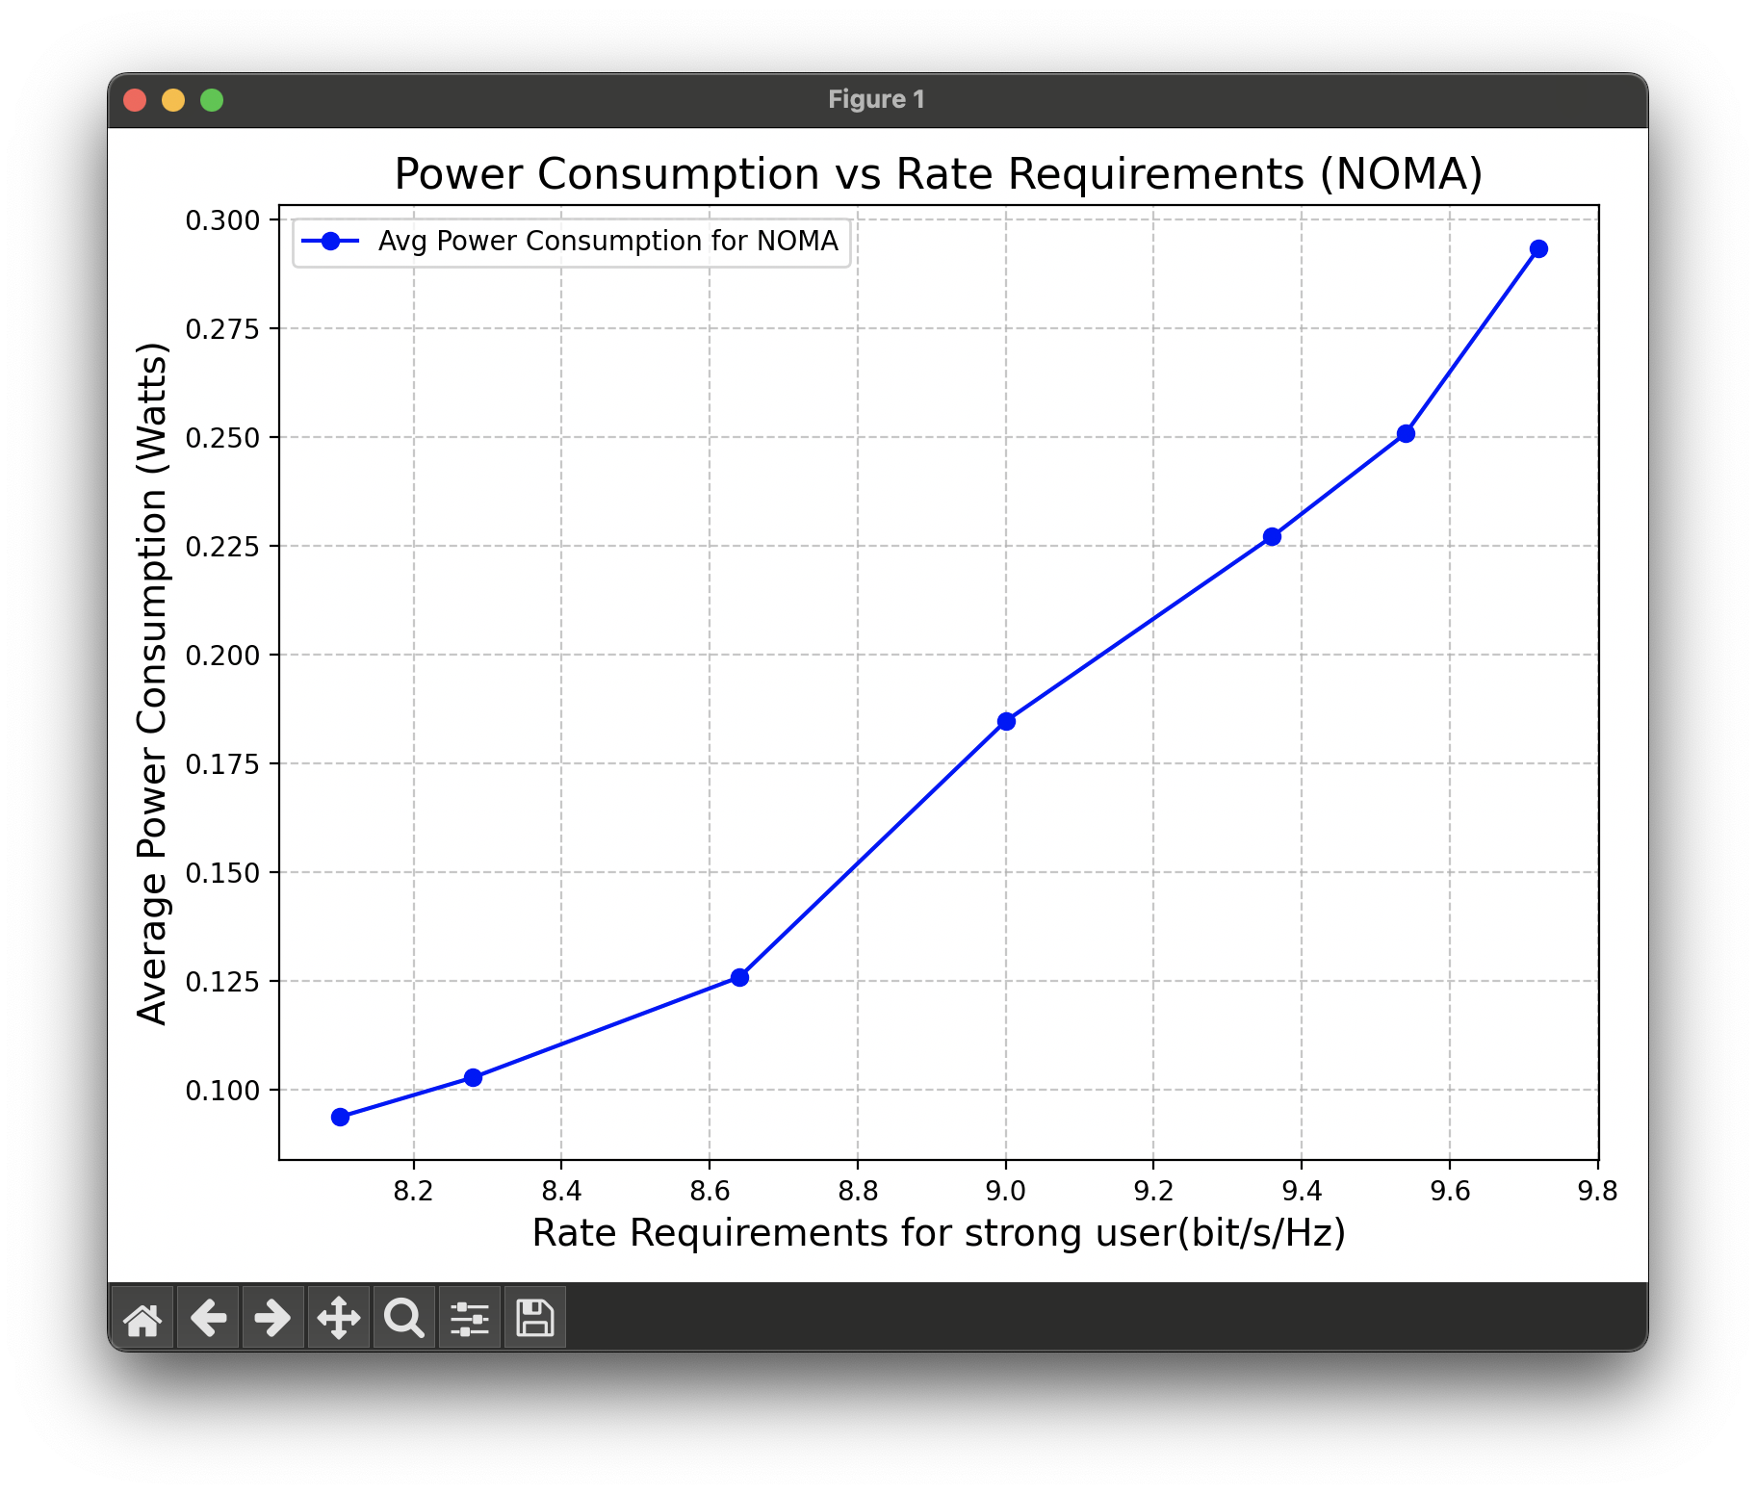

Simulation Results(3/5)
Asymmetric Case

Slide 16
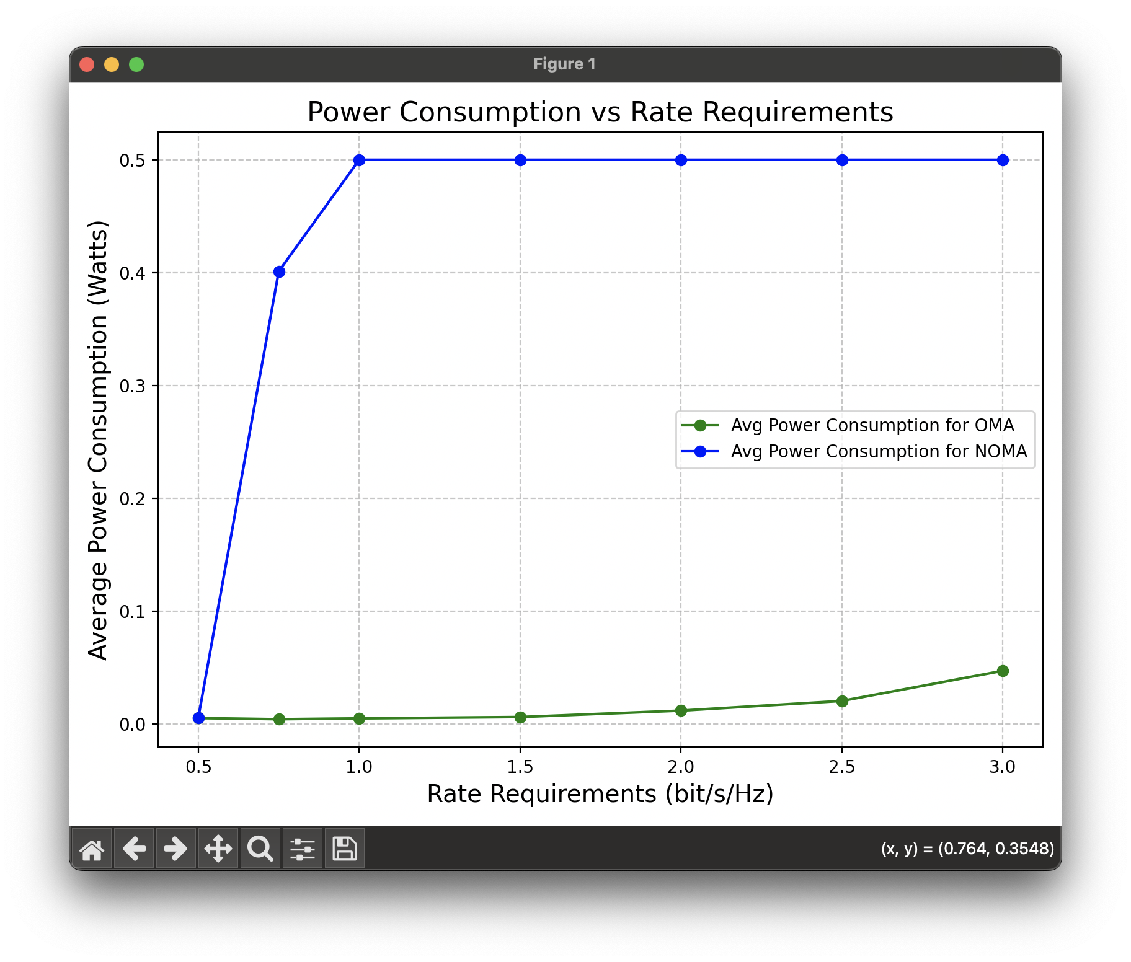

Simulation Results(4/5)
Symmetric Case
NOMA scheme fails to perform effectively, as the equal rate requirements diminish the advantages of SIC, thereby limiting its utility compared to OMA.

Slide 17
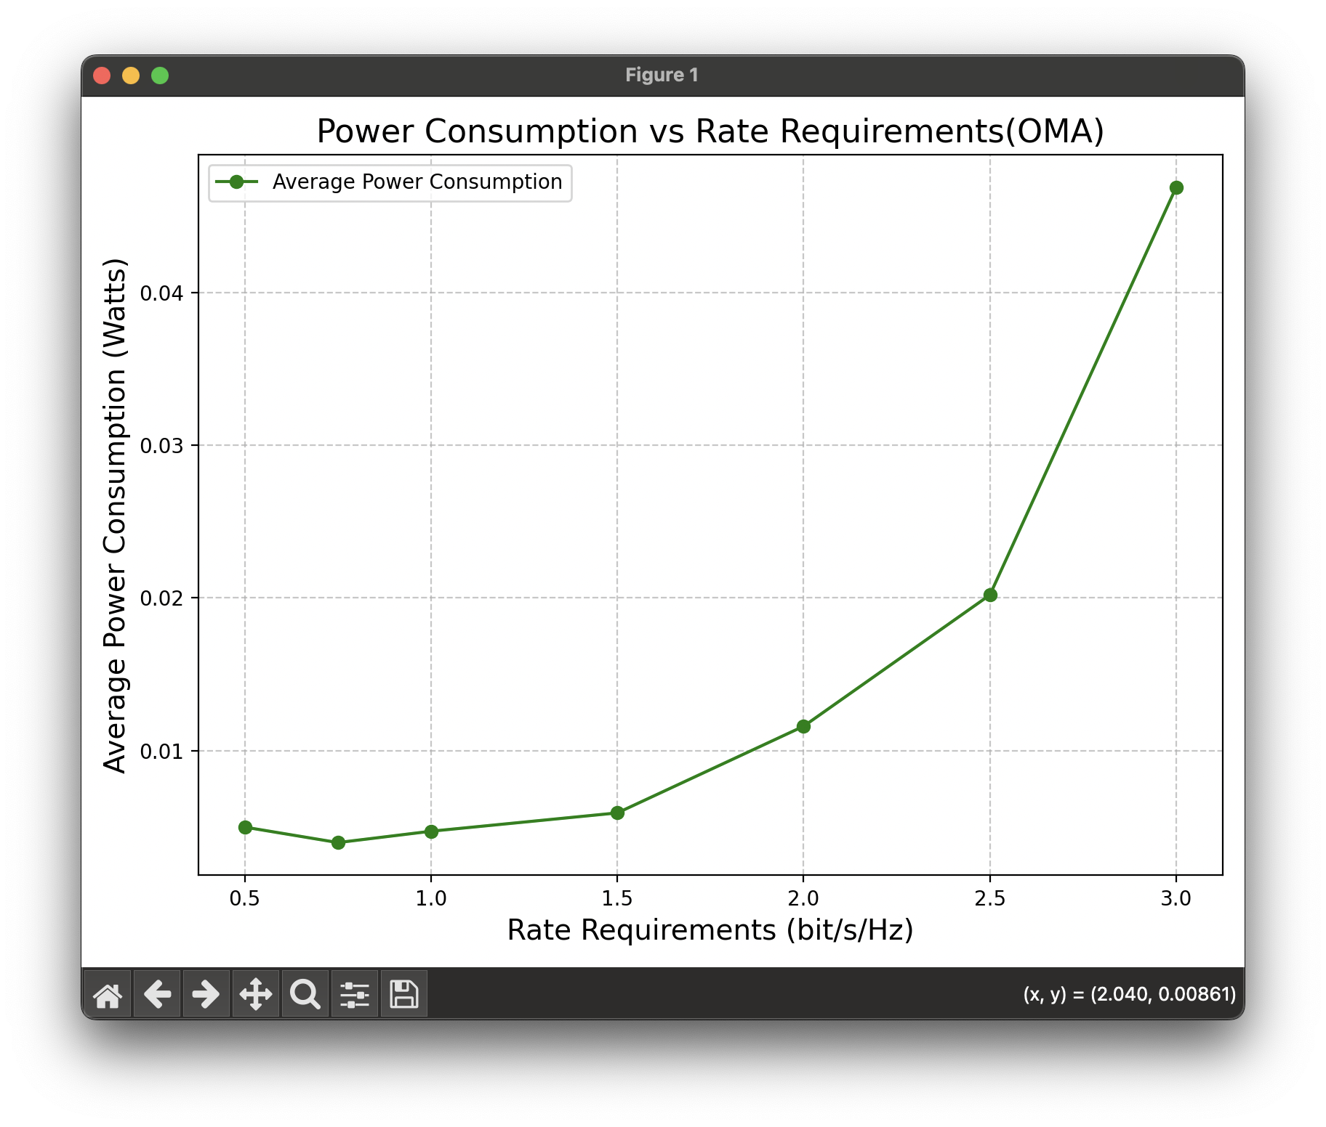

Simulation Results(5/5)
Symmetric Case

Slide 18
Outline
Introduction
What is STAR-RIS?
Key Features
Hardware Design
Communication Model
NOMA
OMA
Problem Formulation
Optimization approach
Overview of Genetic Algorithm
Simulation
Simulation Setup
Simulation Results
Symmetric Case
Asymmetric Case
Conclusion
References

Slide 19

Conclusion
Asymmetric Case
OMA exhibits poor adaptability due to its inability to meet different rate requirements effectively.
NOMA demonstrates superiority through the use of SIC, enabling better noise suppression for the strong user.
Symmetric Case
NOMA's performance diminishes significantly as equal rate requirements reduce the effectiveness of SIC.
OMA performs consistently well under equal rate conditions due to its independent signal detection mechanism.
Comparative Performance
NOMA excels in scenarios with diverse rate requirements (asymmetric).
OMA is preferable in environments with uniform rate requirements (symmetric).

Slide 20
Outline
Introduction
What is STAR-RIS?
Key Features
Hardware Design
Communication Model
NOMA
OMA
Problem Formulation
Optimization approach
Overview of Genetic Algorithm
Simulation
Simulation Setup
Simulation Results
Symmetric Case
Asymmetric Case
Conclusion
References

Slide 21
Reference
GA Note - 基因演算法的世界
Y. Liu, X. Mu, R. Schober and H. V. Poor, "Simultaneously Transmitting and Reflecting (STAR)-RISs: A Coupled Phase-Shift Model," ICC 2022 - IEEE International Conference on Communications, Seoul, Korea, Republic of, 2022, pp. 2840-2845, doi: 10.1109/ICC45855.2022.9838767.
Y. Liu et al., "STAR: Simultaneous Transmission and Reflection for 360° Coverage by Intelligent Surfaces," in IEEE Wireless Communications, vol. 28, no. 6, pp. 102-109, December 2021, doi: 10.1109/MWC.001.2100191.

